Slide 1

Ahimsa Acres Educational Center
Presents
Voluntary Simplicity, Personal Food Choices, and The Environment
With
Dale Lugenbehl and Sandy Lugenbehl

Slide 2
About Dale and Sandy…
We live in Cottage Grove on 8 acres
Built our own home
Grow much of our food
Retired in our 40’s after working part time
We didn’t win the lottery
We didn’t come into an inheritance
But we have consistently chosen to consume at a lower level

Slide 3
Our Focus: Working On Environmental Issues At The Personal Level
Reducing personal consumption is THE most important thing we can do to address the problem of climate change and environmental destruction.

Slide 4
Voluntary Simplicity Is Choosing to Lower My Personal Consumption
We are told we live in a “consumer society,” seeking our fulfillment in acquiring things
Consumption is about the amount of material and energy I consume or use up to support the way I am choosing to live.
We think of consuming as buying or getting stuff
The more of this we do, the more material and energy we use up

Slide 5
Our Reasons For Choosing to Consume Less
Lowering our environmental destructive impact
Make it possible for others to have decent lives: in less developed countries, for future generations, and for all species
Reducing the likelihood of war through reducing scarcity
Reducing the need for paid employment

Slide 6
World Population

Slide 7
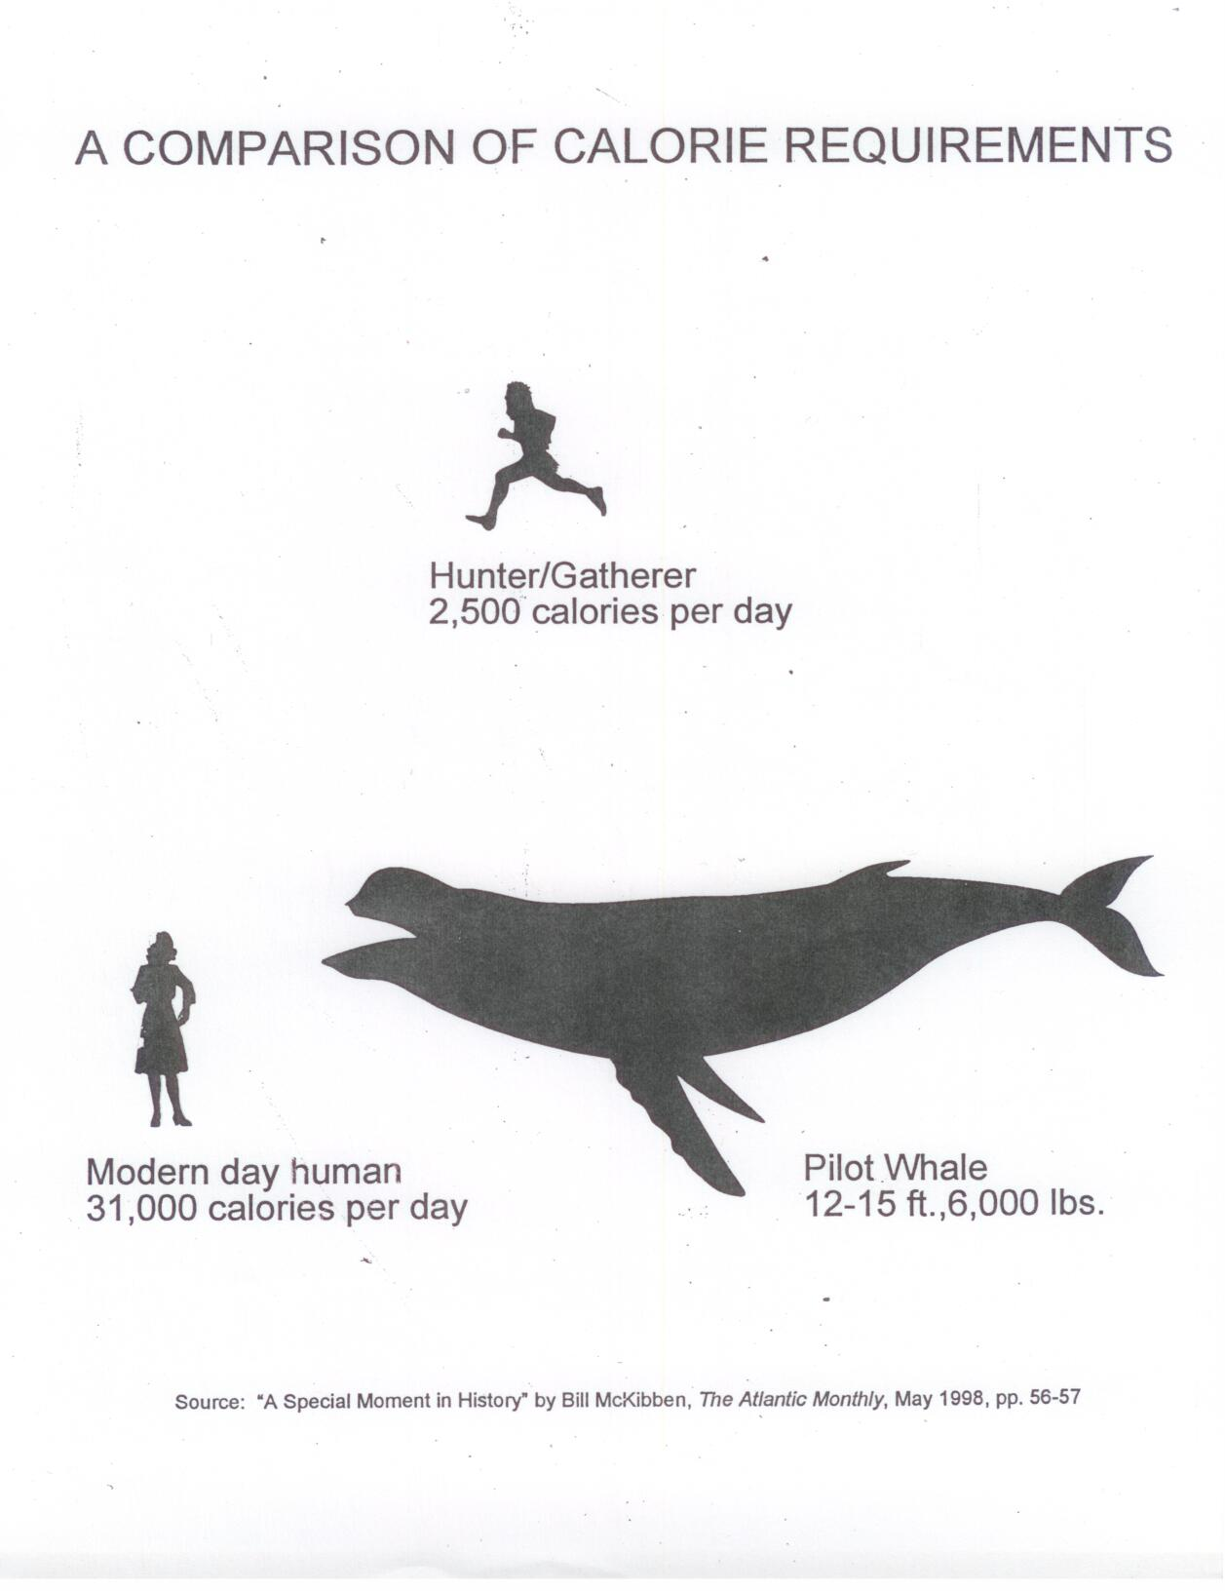

Slide 8
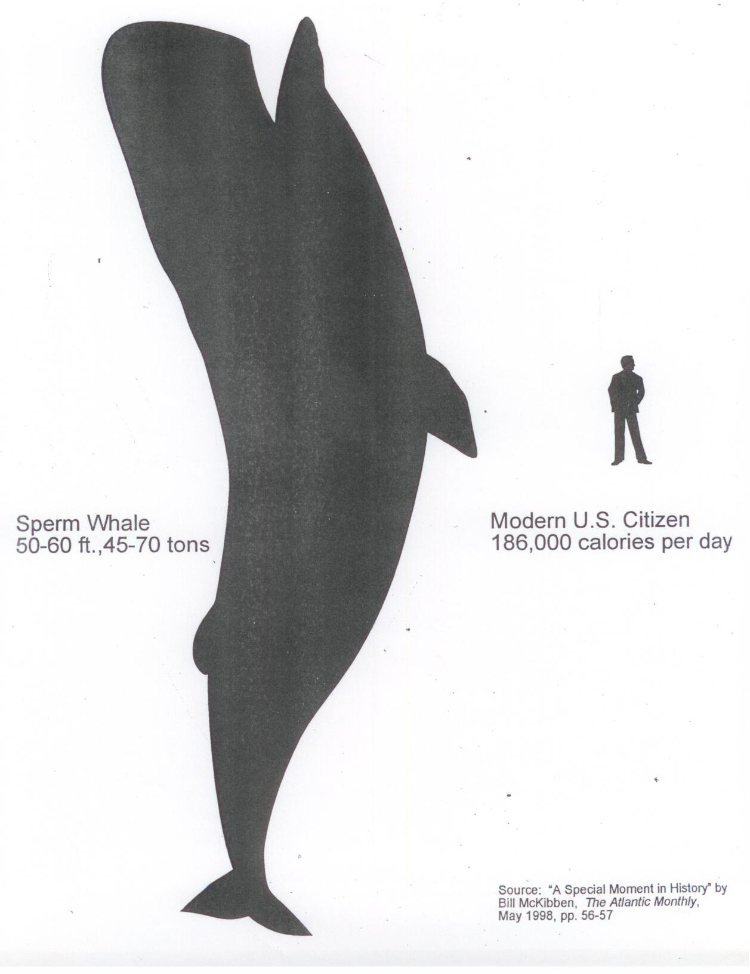

Slide 9
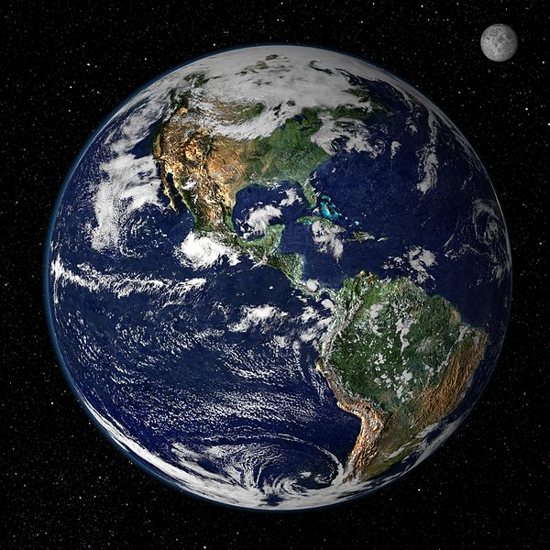
Percentage Increase In Size of Earth: Zero
Earth 1900
Earth 2015

Slide 10
Is It Possible for Everyone on Earth to Consume at the Same Level that U.S. Citizens Do???

Slide 11
Yes, it is possible BUT…

Slide 12
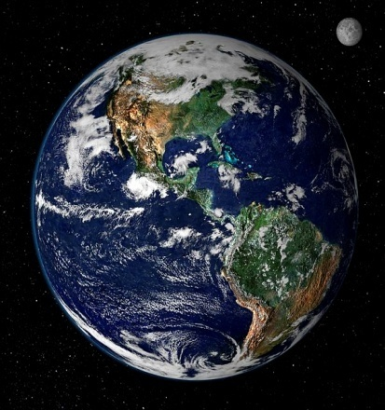

Number of Earths Required to Provide Resources If Everyone Lived Like People In U.S.
3 More Earths Needed
To Provide Resources
Our Present Day Earth

Slide 13
Recycling and Energy
3,200 F = Temperature required to make new glass from limestone, soda ash, and silica
2,800 F = Temperature required to make recycled glass into new glass
212 F = Temperature required to wash out a bottle for re-use as a bottle
0 F = Temperature required if the bottle is not used in the first place
Source: Lane County Master Recycler Training Manual, page II-9.

Slide 14
Recycling and Waste
For every 100 pounds of product sitting on a shelf in a retail store…
3,200 pounds of waste has been created before the product arrives in the store…
This is the result of a chain of events that begins with resource extraction, refining, manufacture, packaging, and shipping…
So how much is accomplished if I recycle the ½ pound of cardboard the product came in???

Slide 15
Importance of Personal Food Choices
Americans spend more than a trillion dollars ($1,000,000,000,000) a year on food.
This amount is more than double what is spent on all U.S. military expenses in a year.
Note: a million = a thousand thousands
    a billion = a thousand millions
    a trillion = a thousand billions
Source: The Way We Eat, by Peter Singer and Jim Mason

Slide 16
Components of Food Choices Impacting the Environment
Plant based diet
Bioregional Foods
Whole Foods
Minimal Packaging
Organic

Slide 17
Steak vs Spaghetti Lunch:
One Half Pound of Food
Steak
6-8 pounds of wheat
1,200 to 2,500 gallons of water
75 units of fossil fuel energy
Spaghetti
¼ pounds of wheat
5 gallons water
1 unit of fossil fuel energy

Slide 18
Conversion Ratios
Conversion Ratios: Pounds of grain and soy fed to get one pound of meat, poultry, or eggs. [Source: USDA, Economic Research Service]

Slide 19
Fate of U.S Food Crops
Percentage of U.S Food Crops Fed to Animals (Source: Diet For A Small Planet

Slide 20
Per-Acre Yields of Usable Protein From Different Food Sources (USDA)

Slide 21
Land Needed to Produce Food for One Person on a Continuing Basis
Notes:
Acres of Land Needed

Slide 22
Gallons of Water Needed to Produce One Pound of Edible Food
Note: Figure for meat is an average for all kinds of meat. [Source: The Restore-Our-Planet Diet, by Patricia Tallman, 2015]
Gallons of Water Per Pound

Slide 23
Got Cow’s Milk…?

Slide 24
Water Needed Per Day to Produce Food for One Person
Notes:
Acres of Land Needed

Slide 25
Hydraulic fracturing (fracking) for natural gas in the U.S. uses a HUGE amount of water…

Slide 26
So fracking is very bad but animal agriculture…
Notes:
Acres of Land Needed

Slide 27
Fossil Fuel Needed to Produce Protein

Slide 28
Water Use in Perspective…
If you take 5 showers a week and
Each shower is 5 minutes and
Your flow rate is 4 gallons/minute
You will use 2,500 gallons of water in 6 months
So you could save 2,500 gallons of water by not showering for 6 months or…

Slide 29
Or you could…
Not eat a single pound of beef and save the same 2,500 gallons of water.

Slide 30
Animal Manure
Animal waste in the U.S. amounts to over 2.0 billion tons annually, equivalent to the waste of 2 billion people (7 times the U.S. population)…
And none of these animals are using toilets or sewage treatment systems; they just go on the ground. (Environmental Science and Technology, Vol. 4, No 12, 1970, p. 1098. Reprinted in Small Planet, p. 21)
Concentration of 10,000 to 300,000 animals in one feed lot produces more fertilizer than surrounding farmland can use, and it's not economical to transport it.

Slide 31
Manure…
Result: Most of the sewage ends up in the water systems we depend on.
The contribution of livestock to water pollution is more than 10 times that of people and more than three times that of all other industry combined. This is not just about beef: it is chicken, pork dairy, eggs, too. (George Borgstrom, The Food and People Dilemma, Duxbury Press, p. 103. Reprinted in Small Planet, p. 22.)

Slide 32
Is Fish Farming Any Better?
40% of U.S. fish is factory farmed
Salmon, tuna, and sea bass are carnivores
It takes 3 to 5 lbs of wild caught fish captured by fishing boats as feed to make 1 lb of fish that humans eat
5 million people live in Scotland
Scottish fish factory farms produce the manure equivalent of 9 million people
This manure is released untreated into the ocean
[“Sea Cage Farming: An Evaluation of Environmental and Public Health Aspects,” by Don Staniford, presented to European Parliament’s Committee on Fisheries, October 1, 2002]

Slide 33
Climate Change
“Over 51% of all worldwide annual green house gas emissions are due to the raising of livestock (cattle, pigs, chickens).” (Robert Goodland and Jeff Anhang, “Livestock and Climate Change,” World Watch, November/December, 2009, pp. 10-19.)
“The cattle population of the Earth weighs more than the entire human population. In 1992, there were 1.28 billion cattle on the Earth, taking up nearly 24% off the land mass of the planet.” (Jeremy Rifken, Beyond Beef, Dutton, 1992, p. 1)

Slide 34
3 Main Greenhouse Gases: Relative Power to Produce Greenhouse Effect

Slide 35
Cattle World-Wide Produce…
150 billion gallons of methane every day!
Source: Thornton, Phillip, Mario Herrero, and Polly Erickson, “Livestock and Climate Change,” Livestock Xchange, International Livestock Research Institute (ILRI) website, 2011. Accessed March, 2015 https://cgspace.cgiar.org/bitstream/handle/10568/1060/IssueBrief3.pdf

Slide 36
Destruction of Topsoil…
Two hundred years ago, most of America's croplands had at least 21 inches of topsoil. Today, most of it is down to around six inches. (Robin Hur, "Six Inches from Starvation: How and Why America's Topsoil is Disappearing," Vegetarian Times, March 1985, pp. 45-47)
It takes natural processes 500 years to build an inch of topsoil. (Curtis Harnack, "In Plymouth County, Iowa, The Rich Topsoil's Going Fast," New York Times, July 11, 1980)
Currently, U.S. croplands are losing an inch of topsoil every 16 years (see Hur, and Pimental et al, "Land Degradation: Effects on Food and Energy Resources," Science, Vol 194, Oct 1976)
The U.S. Soil Conservation Service reports that over 4 million acres of cropland are being lost to erosion in this country every year. The annual topsoil loss amounts to 7,000,000,000 [7 billion] tons, or 60,000 pounds for each member of the country's population. (Hur)

Slide 37
Topsoil…
Of this total topsoil loss, 85% is directly associated with livestock raising. (Hur, Pimental)

Slide 38
Destruction of Forests…
The U.S is presently more than 97% deforested relative to when Europeans first arrived
Since 1967, the rate of deforestation has continued at the rate of one acre every 5 seconds (John Robbins, Diet for a New America, Stillpoint Publishing, 1987, p. 361)
What is responsible for the continuing deforestation???

Slide 39
Deforestation…
For each acre of American forest that is cleared to make room for parking lots, roads, houses, shopping centers, and so on…
Seven acres of forest are converted into land for grazing livestock and/or growing livestock feed. (Robin Hur and David Fields, "Are High-Fat Diets Killing our Forests?“ Vegetarian Times, February 1984)

Slide 40
Is Grass-fed beef better for the environment…??
Let’s investigate…

Slide 41
Grass-fed cattle live longer
Grain-fed factory-farmed cattle reach slaughter weight at 15 months and…
Grass-fed cattle reach slaughter weight at 23 months so…
Grass-fed cattle live 50% longer and continue to produce nitrous oxide, methane, and C02 for all of that additional time.
Source: The Sustainability Secret: Re-thinking Our Diet to Transform the World, by Kip Anderson and Keegan Kuhn, 2014, p. 44. These figures are for grass-fed animals without growth enhancing technology (drugs).

Slide 42
Because of their diet, grass-fed cattle produce…
60% to 400% more methane per day than grain-fed cattle raised on factory farms
Source: Jeff Anhang, environmental specialist with World Bank’s Environment and Social Development Department http://www.brilliantplanet.org/environmental-articles.

Slide 43
Because grass-fed cattle are leaner…
It would take 50.2 million additional cattle to provide the same amount of beef as is currently being provided by grain-fed cattle: 26 billion pounds per year in the U.S.
Source: Dr. Jude Capper, adjunct professor of dairy sciences at Washington State University, “The Environmental Impact of Grain-fed vs. Grass-fed Beef,” April 27, 2012. www.academia.edu/1720592/The_Environmental_Impact _of_Grass-fed_vs._Grain-fed_Beef. Cited on p. 43of The Sustainability Secret by Kip Anderson and Keegan Kuhn. These figures are for grass-fed animals without growth enhancing technology (drugs).

Slide 44
Could all meat be produced from grass-fed cattle…???
It takes about 11.7 acres to produce the 209 lbs of meat eaten by the average American each year. U.S. population = 314 million, so…
It would take 3.7 billion acres to provide this amount of meat from grass-fed cattle…
But… there are only 1.9 billion acres in the lower 48 states and…
Source: The Sustainability Secret: Re-thinking Our Diet to Transform the World, by Kip Anderson and Keegan Kuhn, 2014, pp. 42-43.

Slide 45
Could all meat be produced from grass-fed cattle (continued)…???
Half of the land in the U.S. is already being used for animal agriculture and…
Much of the remaining land is not usable for this purpose: cities, mountain tops, deserts…
Source: The Sustainability Secret: Re-thinking Our Diet to Transform the World, by Kip Anderson and Keegan Kuhn, 2014, pp. 42-43.

Slide 46
Environmental Impacts
Source: The Sustainability Secret, pages 161-162
Omnivore Diet
100% Plant Diet

Slide 47
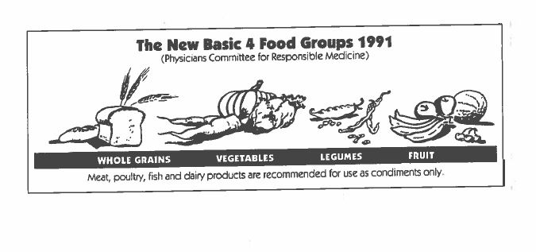
1991

Slide 48
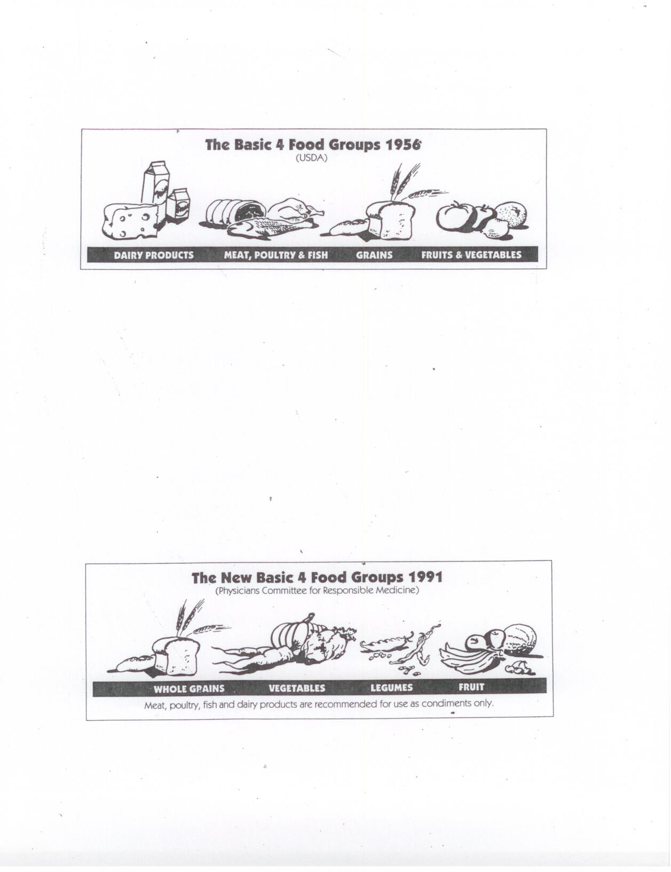

Slide 49
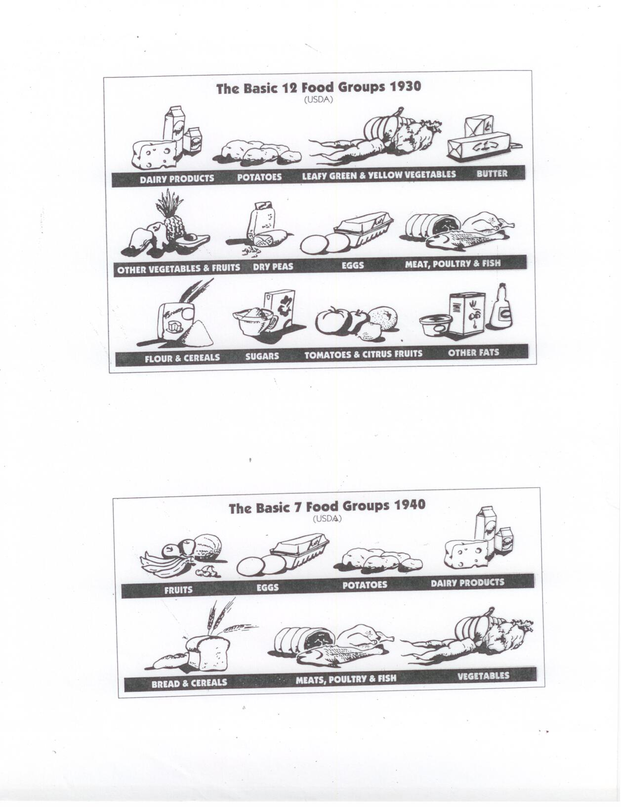

Slide 50
MyPlate: Current U.S. Government Food Groups

Slide 51
Federal Dietary Guidelines vs Federal Food Subsidies
(Physicians Committee for Responsible Medicine, 2007)

Slide 52
Bioregional Food
“Bioregional” means getting the things needed to sustain your life in the region where you live.
In the U.S. the average food item on someone’s plate has travelled 2,000 miles to get there.
Food that has travelled thousands of miles to get here contains large quantities of “embodied energy” and “embodied pollution” (including greenhouse gases).

Slide 53
How Do I Know It’s Local?
Read the label for a point of origin.
Educate yourself about what is grown in your area
Be aware of growing seasons because…
Even if cantaloupe ARE grown locally, this does not mean that the particular cantaloupe that you bought was grown locally.
Know your farmer!

Slide 54
Whole Foods
A whole food is there in its whole and natural form such as…
An apple, a potato, corn kernels, nuts, beans, vegetables
If you ate a whole donut, you did not eat a whole food!
Foods that are not in their whole form come with varying degrees of processing and “refinement.”
Let’s look at some examples…

Slide 55
Minimal Packaging
Bulk bins; bring your own container and weigh it first
Bulk bags (Ask!)
Farmer’s markets
Grow your own
CSA’s
All of these measures can also reduce your dollar cost and result in better quality food.

Slide 56
Why Organic?
Organic food uses fewer fossil fuels to produce
Organic food puts less poison on your food and in the environment (chemicals do not stay put)
Pesticides have a long half life (remember DDT?)
Your dollars will support one form of agriculture or another: who do you want to help keep going?

Slide 57
How Do I Know Its Organic?
Grow it yourself!
Get to know your farmer.
Learn to read supermarket labels:
  A 4 digit number means it’s NOT an organic product: 4011 is a code for a nonorganic banana.
  A 5 digit number that begins with a 9 is an organic a product: 94011 is a code for an ORGANIC banana
  Some foods that are not organic are given almost no pesticides. You can find a list of these foods on-line.

Slide 58
Moving Toward Voluntary Simplicity: Some Tools
A rethinking of money
REAL hourly wage
REAL cost of a purchase
A rethinking of what economic security means
The true nature of unhappiness: the wisdom of Epictetus

Slide 59
What is money, anyway…?
Money is something that you trade the hours of your life for…
You are actually selling pieces of your life to your employer in exchange for money
How much are you really selling your life for…???

Slide 60
Your apparent hourly wage…
If you work 40 hours a week and your earn $400, then it would appear that you are selling your life at the rate of $10 per hour…
But are you really…?
Your REAL hourly wage is likely to be quite different!

Slide 61
To calculate your REAL hourly wage you must…
Adjust your hours by adding hours for…
Commuting time
Decompression
Getting ready time
Working at home, complaining, losing sleep
Lost time for job related illness
Adjust your income by subtracting job expenses…
Commuting costs
Decompression
Special clothing or equipment
Union dues
Added food costs
Child care
Taxes
Job related health expenses
Let’s look at an example…

Slide 62
“I work 40 hours a week and make $400 but…”
Job costs…
Commute: -$20
Decompression: -$40
Taxes: -$60
Extra clothing cost: -$10
Added food cost: -$15
Total adjustments: $400 minus $145 = $255 REAL pay
Extra hours…
Commute: +4 hrs
Decompression: +6 hrs
Getting ready: +2 hrs
Thinking, worrying, complaining: +4 hrs
Unpaid lunch: +2.5 hrs
Total Adjustments: 40 hrs plus 18.5 hrs = 58.5 hrs REAL hours

Slide 63
“I’m really selling the hours of my life for…”
$4.35 per hour REAL hourly wage
And, this means that if I buy a compact disk for $13 dollars…
The REAL cost of the disk is…
3 hours of MY LIFE

Slide 64
REAL hourly wage and REAL cost of a purchase can be used to…
Decide whether to work at a particular job or not and to…
Decide whether a particular purchase is really worth it to me.

Slide 65
Rethinking Economic Security
We think of economic security as having a high income… But is that really true?
A friend named Mike has his own business making $120,000 a year, and he feels secure.
When his business fails, he goes looking for another job…
And, he has great difficulty in finding an acceptable job.
Why…???

Slide 66
Mike is having trouble because…
There are a limited number of jobs that pay at a level that will take care of him.
Many people would like to make $120,000, so there is a lot of competition for the jobs that are available.
What if Mike reduced his need for income to $60,000…?
To $30,000…?
To $15,000…?
To only $7,000…????

Slide 67
Each Reduction in Your Need for Income…
Increases the number of jobs available to you and…
Makes it possible for you to choose to work fewer hours and…
Makes it possible to choose work that is meaningful, allows for personal expression and creativity, and does not conflict with your deepest values and…
Essentially creates vastly greater FREEDOM in the world of paid employment.

Slide 68
So economic security can be seen as…
Having a high income. This is the traditional, mainstream view.
Or economic security can be seen as…
Having a low need for income.
This is the deep insight of voluntary simplicity: If I lose my job, I can easily replace it with another equally good job.

Slide 69
But Won’t I Feel Deprived If I Have Less Income & Stuff?
We are mistaken about where unhappiness comes from…
We think unhappiness comes from not having lots of money in the bank, a new car, a bigger house, new clothes, more electronic gear…
And, of course, advertising is continually trying to convince us that what we have now is not good enough, but…

Slide 70
Epictetus’ Radical Insight on Unhappiness
Unhappiness is the GAP between “What I have” and “What I want or expect.”
We can close up this gap by trying to get what want but…
We rarely realize that we can also close this gap by changing our wants…
The more we think we have to have, the less likely it is that we will experience happiness.

Slide 71
Reducing Consumption: Implementation
Don’t subscribe to newspapers and magazines
Drink water (unbottled)
Buy in bulk
Buy 2nd hand
Don’t automatically “upgrade” your stuff
Question ritualistic gifts
Downsize your housing
Garden, use CSA’s and farmer’s markets
Use things until they wear out; resist fashion
Don’t shop recreationally
Stop exposing yourself to advertising
Keep an expense log
Eat a plant-based diet
Avoid processed foods

Slide 72
A Final Point to Remember…
Having a more accurate mental model of our actual situation will automatically cause us to make different and better choices…
If you see the world differently, you will act differently.

Slide 73
Ahimsa Acres Educational Center
We May Be Reached at
Website: Ahimsaacres.org
Emails:
ahimsaacres@gmail.com
lugenbehld@lanecc.edu
aldridgesandy@gmail.com

